Slide 1
Multi-thing IoT Applications
Huichong, Jose, Justina, Mark, Nehal, Sean

Slide 2
Overview
GOAL:
Create two IoT applications that monitor device locations in real-time over OpenDaylight
Mobile “people-finder” app
Web browser “heat map”
Create an API where third party applications can interface with in the future
Combining BLE, CMX, GPS to provide ultimate location accuracy
Solution Components
Devices
Reasoner (Logic)
Application
ODL IoT data store
Overall Functions
Updating map with real-time data
Providing heat map of people traffic over time
Finding/searching user locations
Prioritize beacon/CMX/GPS location data
Notes:
Jose

Slide 3
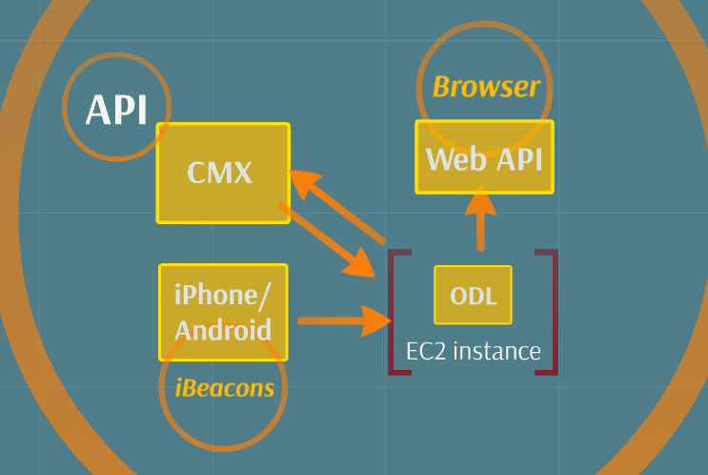
Flow Chart
Notes:
Jose

Slide 4
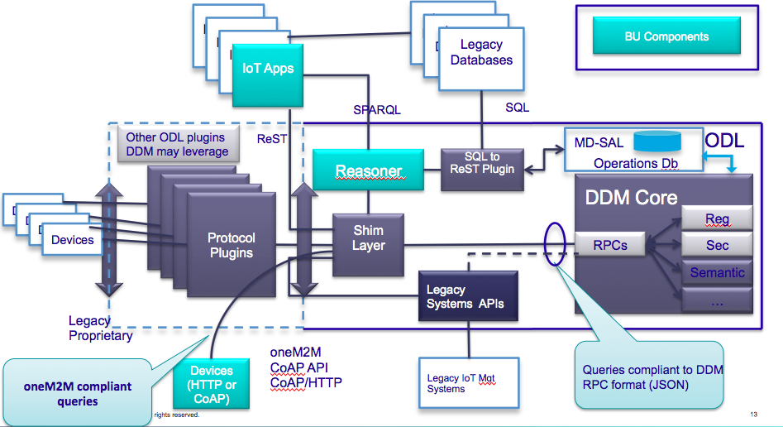
Data Flow
Notes:
Justina

Slide 5
Design Decisions
Input Fields
Priority of location data
Beacons -> CMX -> GPS
Unique Identifiers
Two trees: Location and User
Update Mechanism
Beacons & CMX - 950ms (GPS not as often)
On PUSH Notifications/Subscription
Notes:
Justina

Slide 6
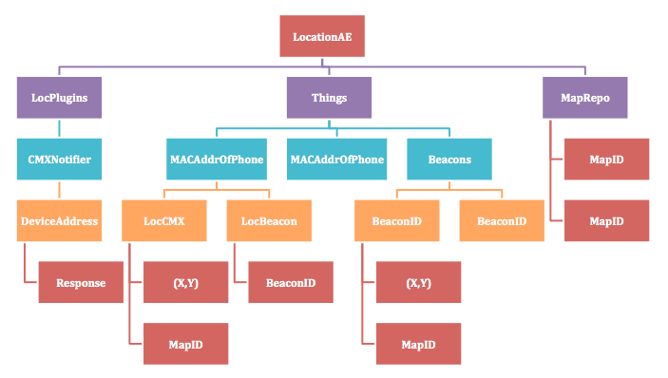
Our IoT Tree
Notes:
Sean
don’t mind the LocPlugins on left (for CMX later)
didn’t include UserAE tree which is just basically UserAE -> UserID -> UUID or MACAddrOfPhone

Slide 7
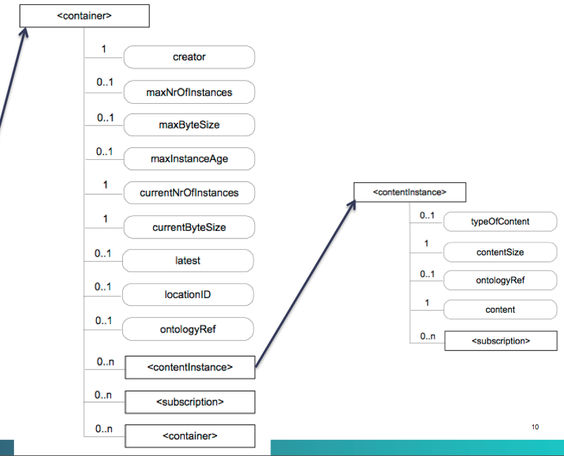
Creating Content Instance Example
/* used this JSON payload to create content instances */
{
"from":"http:localhost:10000",
"requestIdentifier":"12345",
"resourceType":"contentInstance",
"content": {
"contentInfo":"ID1",
"content":beaconID
}
}
Notes:
Sean

Slide 8
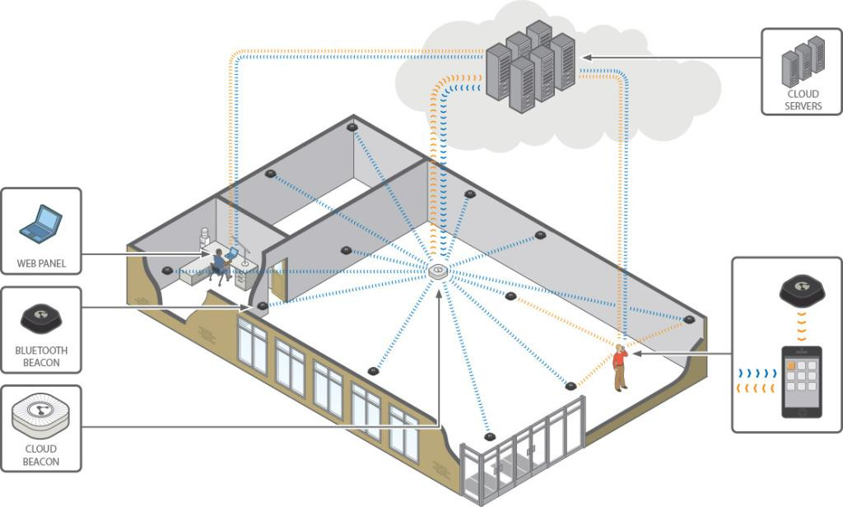

Indoor Beacon Mapping
Notes:
Mark

Slide 9

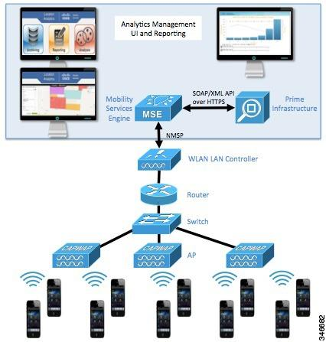
CMX
Connected Mobile Experiences
Using your Cisco wireless network and location intelligence from the Mobility Services Engine (MSE), CMX helps you create personalized mobile experiences for mobile end users and gain operational efficiency with location-based services.
Detect, Connect and Engage Users In-Venue
Dynamically updating location data
Gain meaningful analytics
Indoor Maps / Heat mapping
Notes:
??

Slide 10
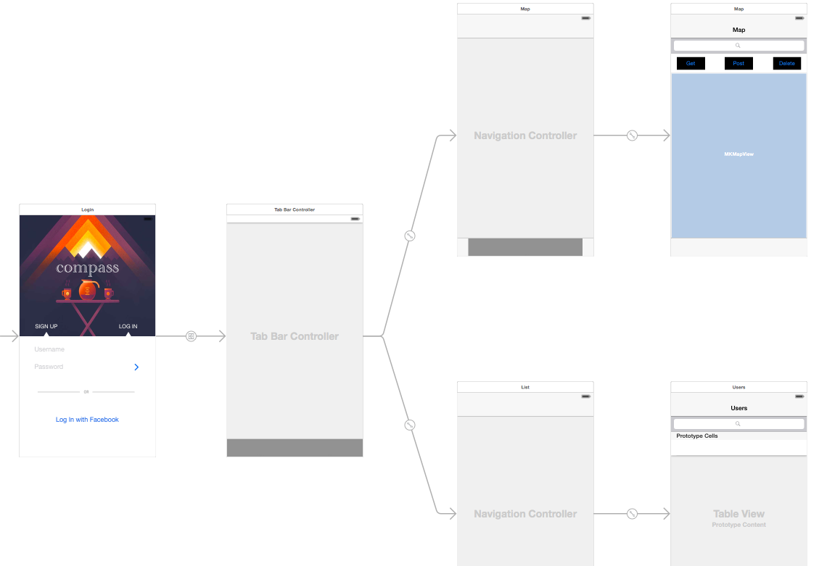
App Development
Device application functions:
Secure user registration
Real time location monitor
User can search for others locations and are pinged of their current location
App will load indoor / Google map based on precise location
Notes:
Mark

Slide 11
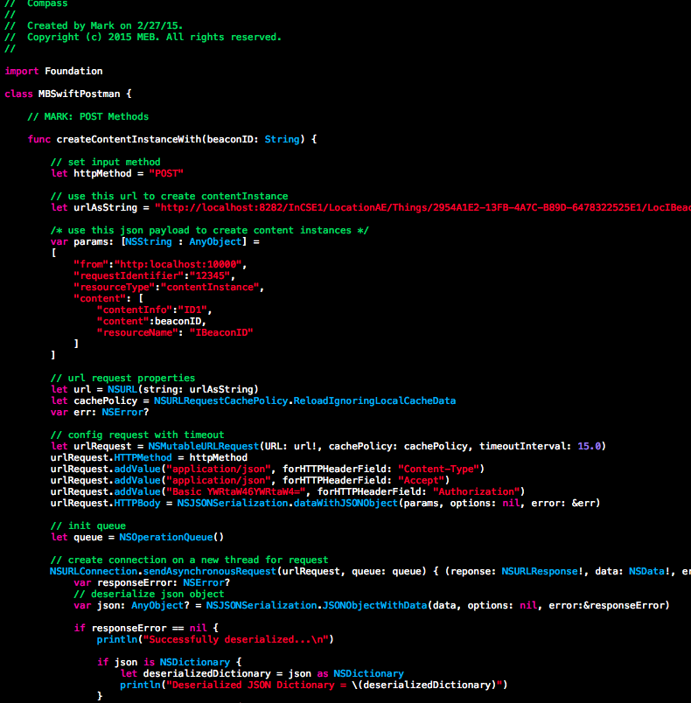
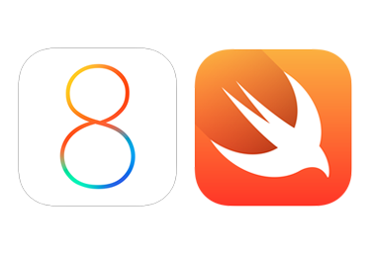
App Development
Swift API functions:
POST, GET, DELETE
Determine locating method priority (BLE, CMX, GPS)
Update/POST content instances with location data based on DeviceID and/or UserID
GET user location data
GET current Map ID
Pass location data to map view
Notes:
Android App Screenshots

Slide 12
Browser App Development
Functionality :
Heat Map for Tracked Devices
Switching between CMX API and a combination of Google Maps with Indoor Maps
Trail of Location using History of Locations to draw out path a device followed between start and end
Update Location/Devices using PUSH Notifications and Timeouts
Notes:
Nehal

Slide 13
Our future plans: Next Steps
Dynamically create content instances based on beacon, then CMX, then GPS
Configure API so other apps can use it (FourSquare, Life360, etc.)
Finish mobile apps / web browser app UI/UX
Create Location Manager program to statically create entire structured tree
Notes:
Huichong

Slide 14
Questions?
Gracias

